Slide 1
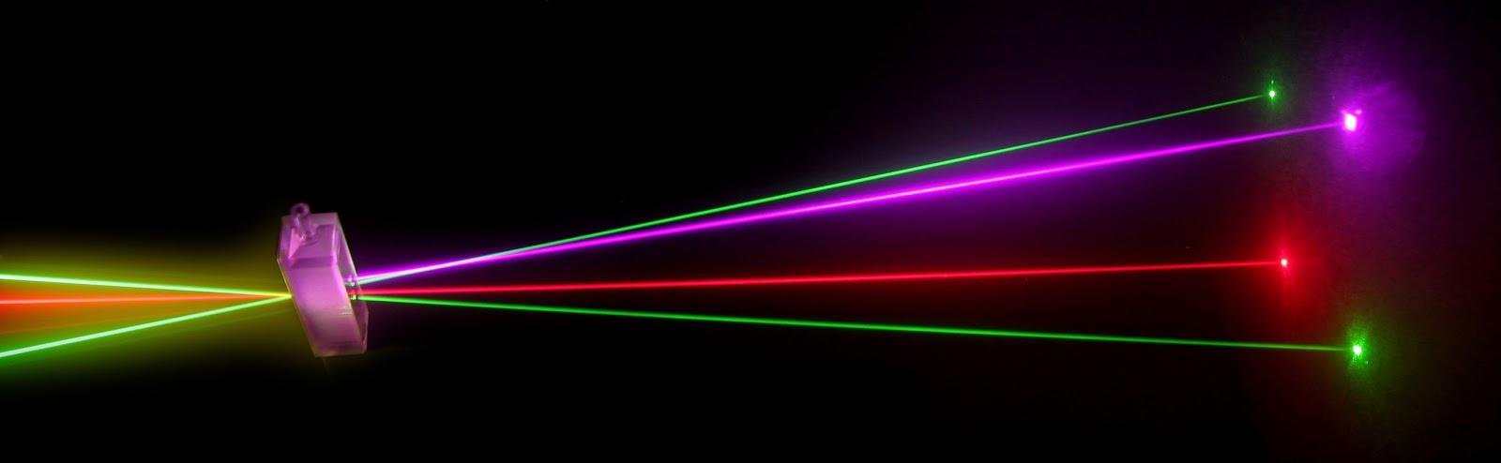
“Laser Technology and Applications” 16B1NPH533 Lecture 29-31

Slide 2
Lecture 29 Content Outlines
STABLE CURVED MIRROR CAVITIES
Curved Mirror Cavity
- ABCD Matrix: brief summary of matrix approach to light ray optics
In the next few lectures stability of the cavities will be determined by doing an analysis using ABCD matrices considering which laser cavities would allow a laser beam to operate on a steady-state basis with a uniform stable power output.

Slide 3
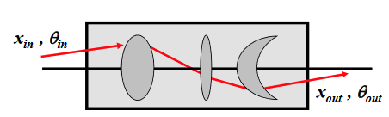
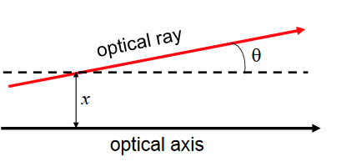
Light Ray Optics
Each optical system will have an axis, and all light rays will be assumed to propagate at small angles to it (Paraxial approximation)optical axis. We define all rays relative to the relevant optical axis
Ray Vector
A light ray can be defined by two
co-ordinates:
Position : x and slope:θ
These parameters define a ray vector,
which will change with distance as the
ray propagates through the optics.

Slide 4
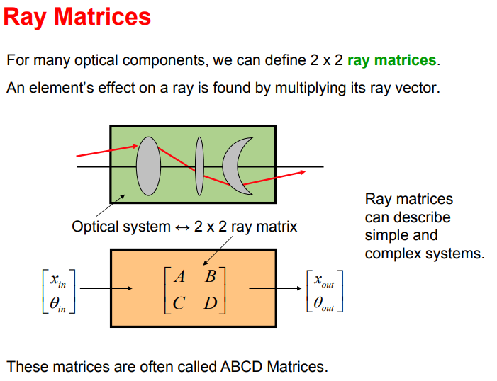

Slide 5
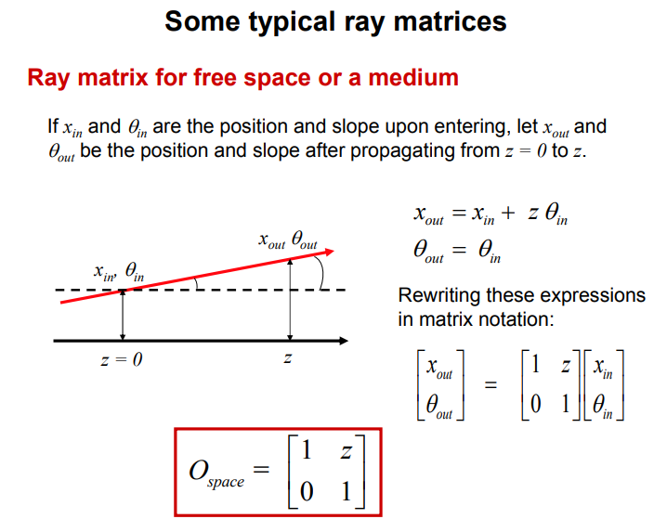

Slide 6
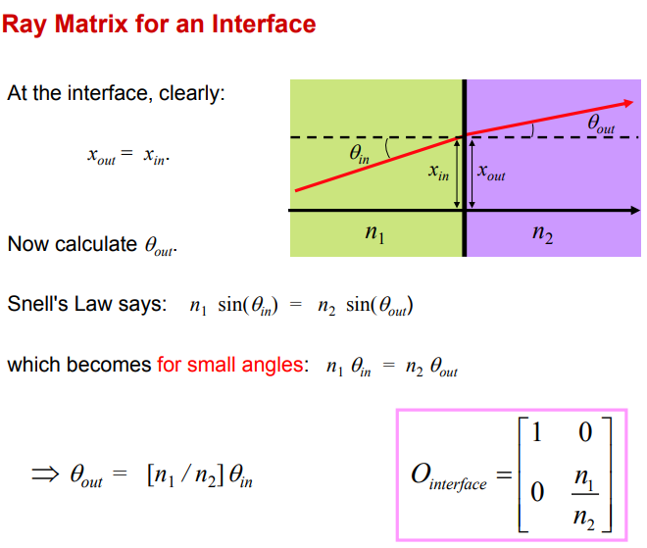

Slide 7
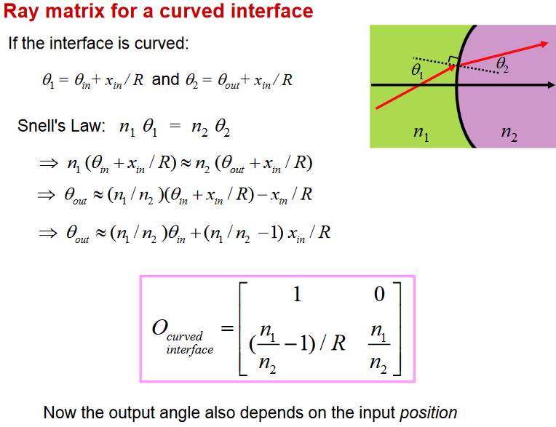

Slide 8
STABLE CURVED MIRROR CAVITIES
- ABCD Matrix
Matrices of Simple Optical Components
Difference Equation for the Ray Position

Slide 9
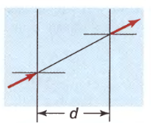
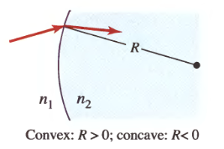
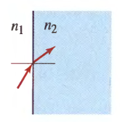
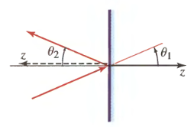
Free-Space Propagation
Refraction at a Spherical Boundary
Refraction at a Planar Boundary
Reflection from a Planar Mirror

Slide 10
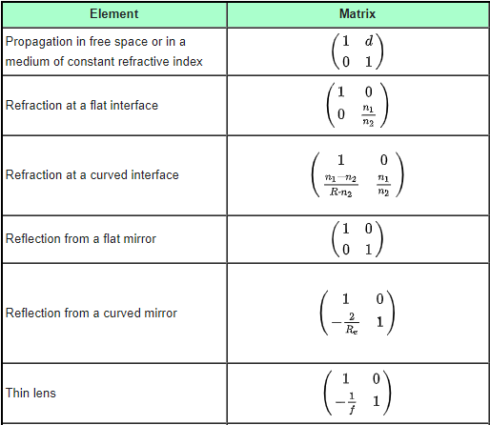
Table of ray transfer matrices

Slide 11
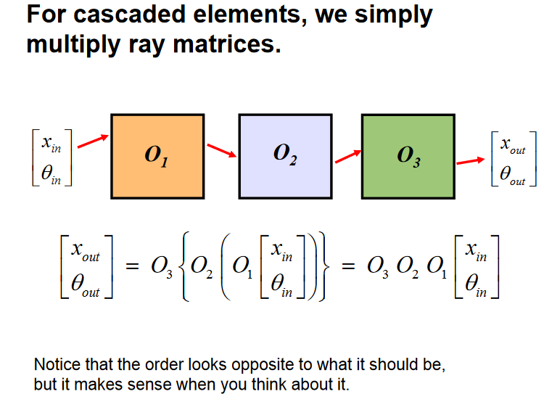

Slide 12

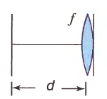
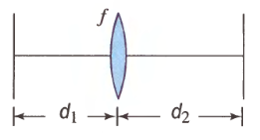
Matrices of Cascaded Optical Components
A cascade of N optical components or systems whose ray-transfer matrices are
M₁ , M₂ , . . . , M_{N} is equivalent to a single optical system of ray-transfer matrix

Slide 13
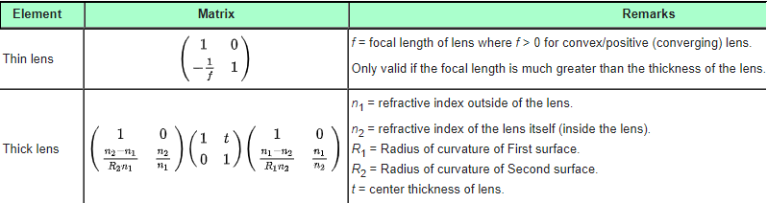
Table of ray transfer matrices

Slide 14
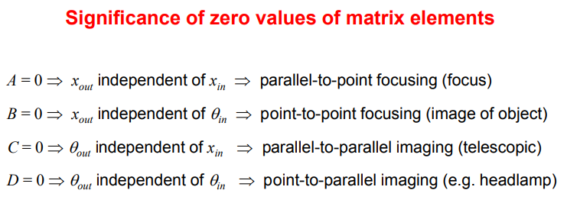

Slide 15
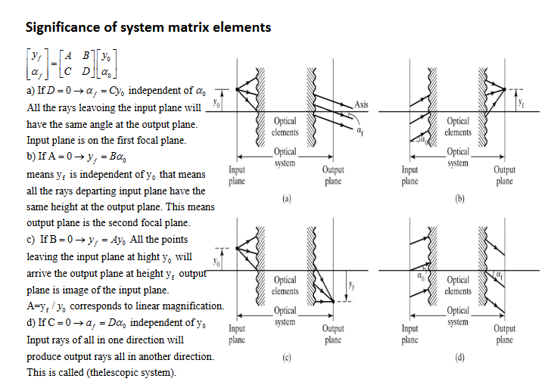

Slide 16
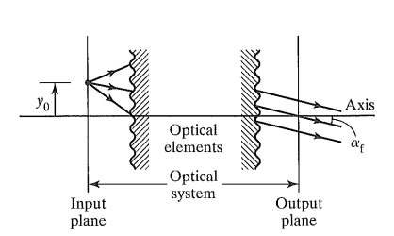

Significance of System Matrix Elements
Case I: D = 0. In this case, α_{f} = Cy_{o}, independent of α_{o}. Since y_{o} is fixed, this means that all rays leaving a point in the input plane will have the same angle α_{f} at the output plane, independent of their angles at input. The input plane thus coincides with the first focal plane of the optical system.

Slide 17
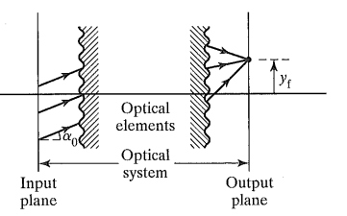
Significance of System Matrix Elements
Case II: A = 0, y_{f}= Bα_{o} implies that y_{f}, is independent of y_{o}, so that all rays departing the input plane at the same angle, regardless of altitude, arrive at the same altitude y_{f} at the output plane. The output plane thus functions as the second focal plane.

Slide 18
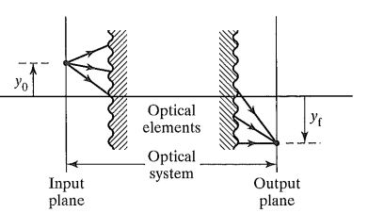
Significance of System Matrix Elements
Case III: B = 0. Then y_{f} = Αy_{o}, independent of α_{o}. Thus, all rays from a point at height y_{o} in the input plane arrive at the same point of height y_{f} in the output plane. The points are then related as object and image points and the input and output planes correspond to conjugate planes for the optical system. Furthermore, since A =y_{f}/y_{o} ,the matrix element A represents the linear magnification.

Slide 19
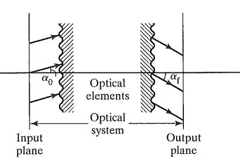
Significance of System Matrix Elements
Case IV: C = 0. Now α_{f}= Dα_{o}, independent of y_{o}. This case is analogous to case 3, with directions replacing ray heights. Input rays, all of one direction, now produce parallel output rays in some other direction. Moreover, α_{f}/α_{o} is the angular magnification. A system for which C = 0 is sometimes called a "telescopic system," because a telescope admits parallel rays into its objective and outputs parallel rays for viewing from its eyepiece.

Slide 20
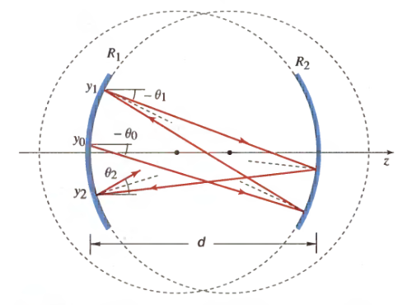
Prerequisite Exercise: An Optical Resonator. Paraxial rays are reflected repeatedly between two spherical mirrors of radii R 1 and R 2 separated by a distance d. Regarding this as a periodic system whose unit system is a single round trip between the mirrors, determine the condition of stability for the ray trajectory.

Slide 21
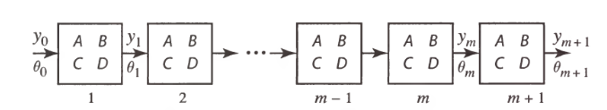
Difference Equation for the Ray Position
A periodic system is composed of a cascade of identical unit systems (stages), each with a ray-transfer matrix (A, B, C, D) .
A ray enters the system with initial position y_{o} and slope θ_{o}. To determine the position y_{m} and slope θ_{m} of the ray at the exit of the m^{th} stage, we apply the ABCD matrix m times,
Or apply the relations iteratively
and det [M] is the determinant of M.

Slide 22
As with linear differential equations, a solution satisfying a linear difference equation and the initial conditions is a unique solution. We use a trial solution of the geometric form
where h is a constant. Substituting in recurrence relation for ray position shows that the trial solution is suitable provided that h satisfies the quadratic algebraic equation
from which ,

Slide 23
The sum of the two exponential functions can be written as a harmonic (circular) function, so that
F=det[M], for any unit system det[M]=n₁/n₂ if the initial and the final medium are same then n₁=n₂ and hence F=1 even for cascaded system.

Slide 24
Condition for a Harmonic Trajectory
For y_{m} to be a harmonic (instead of hyperbolic) function, 'ϕ=cos⁻¹ b must be real. This requires that
The bound |b| ≤ 1 therefore provides a condition of stability (boundedness) of the ray trajectory.
Since y_{m} and y_{m +1} are both harmonic functions, so too is the ray angle. Thus, θ_{m}=θ_{max}sin(mϕ+ ϕ₁), where the constants θ_{max} and ϕ₁ are determined by the initial conditions. The maximum angle ϕ_{max} must be sufficiently small so that the paraxial approximation, which underlies this analysis, is applicable.

